Slide 1
Craft Beers and Breweries Study For Budweiser
MSDS 6306: Case Study 01
Troy McSimov, Katon Pang

Slide 2
Exploratory Data Analysis (EDA)
Basic review of summary statistics
Approach to address missing values
Observations of data relationship
Organizing data and plotting for further analysis
Next steps in completing EDA

Slide 3
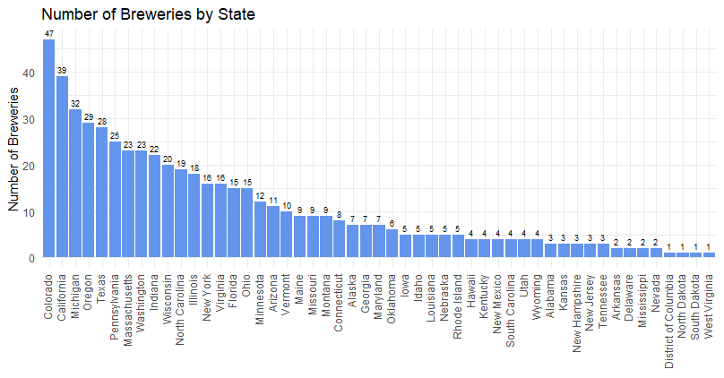
Review of Datasets
Breweries.csv (558)
- ID (PK)
- Name
- City
- State
Beers.csv (2,410)
- Name
- Beer ID (PK)
- ABV
- IBU
- Brewery ID (FK)
- Style
- Ounces

Slide 4
Addressing Missing Values
Original data:
ABV missing: 62 out of 2410 = 2.6%
IBV missing: 1005 out of 2410 = 42%
Style missing: 5
Address missing values with research:
ABV missing: 15 out of 2410 = 0.6%
IBU missing: 944 out of 2410 = 39%
Style missing: 3
After impute IBU missing values:
IBV missing: 11 out of 2410 = 0.46%
Impute missing IBU values with the median of IBU for that style of beer

Slide 5
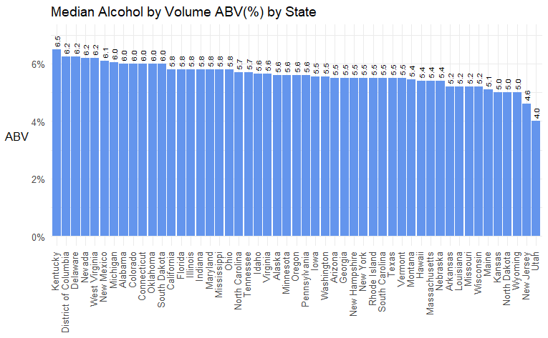
Median ABV and IBU by State

Slide 6
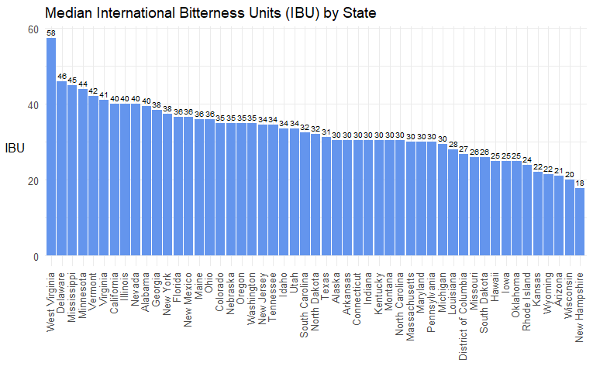
Median ABV and IBU by State

Slide 7
Comparing ABV and IBU by State
Kentucky led the States in highest average % alcohol, while West Virginia led the States in bitterness.
While Kentucky was highest in ABV it scored in the lower half for IBU.
West Virginia was in top 5 for both ABV and IBU.
Interesting finding!

Slide 8
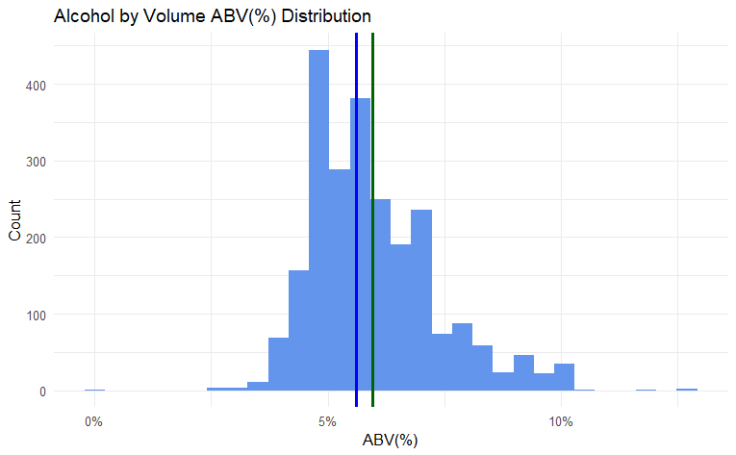
ABV Statistics
Min = 0.1%
1st Quantile (25%) = 5.0%
Median = 5.6%
Mean = 5.97%
3rd Quantile (75%) = 6.7%
Max = 12.8%
Standard Deviation = 1.35%

Slide 9
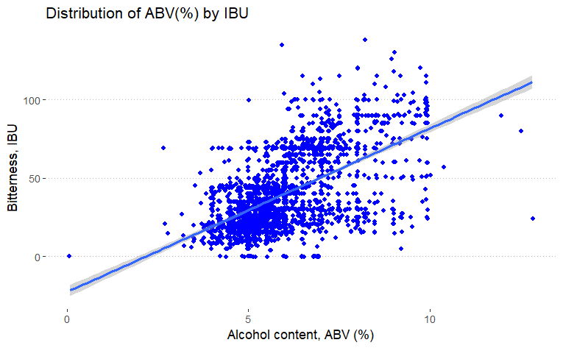
ABV vs. IBU

Slide 10
Next Steps in EDA Process
Classification of Styles to smaller grouping (IPA, Ale’s, and Other)
Further analysis to determine any further trends, interesting findings, and data correlations

